Slide 3
Electricity & Gas Meters
Supported Meter Types
Domestic Credit – Direct Debit and Pay on Receipt of Bill (payment methods).
Domestic Pre Payment – Meters which require topping up. This will be done using a top up key/ card.
SMART – Can be used as either credit or Pre Payment. The supplier can communicate directly with the meter to obtain meter readings, send credit/ debt and change the tariff code.

Slide 4
Transfer Process
Energy Switching
When a customer signs up for a product with Spark they will receive a 14 day cooling off period – this means we cannot order any energy supplies during this time.
Once the 14 day cooling off period has been completed and no cancellation received – both supplies will be ordered for +15days.

Slide 5
Strictly Private and Confidential © Copyright Spark Energy 2015
Our new tariff range
Here’s the summary
A change in terminology
We have four core tariffs
Variable and fixed options
Different payment methods within each tariff
Refreshed model for lettings

Slide 6
Strictly Private and Confidential © Copyright Spark Energy 2015
Four core tariffs…
Tenant Saver (Variable)
Tenant Saver (Fixed)
Direct Debit Advance
Monthly Premium
More options
We have four core tariffs and within each there are a variety of payment methods, so we can offer more choice and better value to all of our customers.

Slide 7
Strictly Private and Confidential © Copyright Spark Energy 2015
Four core tariffs…
Tenant Saver (Variable)
Saver (Fixed)
Direct Debit Advance
Monthly Premium
Variable ‘evergreen’ tariff
Rates can go up as well as down
The default on boarding tariff for all COTs and lettings channel customers - monthly initial payment method will be monthly bill
Pay by Direct Debit, Monthly bill or PAYG

Slide 8
Strictly Private and Confidential © Copyright Spark Energy 2015
Four core tariffs…
Tariff | Description
Tenant Saver (Variable)
Tenant Saver (Fixed)
Direct Debit Advance
Monthly Premium | As per current with no late payment fees, unlikely to attract new customers onto this tariff.
Tenant Saver (Variable)
Saver (Fixed)
Direct Debit Advance
Monthly Premium
Prices fixed till March 2018
Slightly cheaper than Tenant Saver (Variable)
End date aligned with tenancy
TUWY option (no exit fees)
Pay by Direct Debit & PAYG

Slide 9
Strictly Private and Confidential © Copyright Spark Energy 2015
Four core tariffs…
Tariff | Description
Tenant Saver (Variable)
Tenant Saver (Fixed)
Direct Debit Advance
Monthly Premium | As per current with no late payment fees, unlikely to attract new customers onto this tariff.
Tenant Saver (Variable)
Saver (Fixed)
Direct Debit Advance
Monthly Premium
Variable tariff
Rates can go up as well as down
Pay by Direct Debit only
Pay a month in advance
Cheaper than Tenant Saver (Variable)

Slide 10
Strictly Private and Confidential © Copyright Spark Energy 2015
Four core tariffs…
Tenant Saver (Variable)
Saver (Fixed)
Direct Debit Advance
Monthly Premium
Variable tariff
Rates can go up as well as down
Pay by cash / cheque / card with monthly bill
You can move to Tenant Saver (Variable) paying by cash but must have zero arrears after 28 days

Slide 11
Strictly Private and Confidential © Copyright Spark Energy 2015
Four core tariffs – pricing
Tenant Saver (Variable)
Saver (Fixed)
Direct Debit Advance
Monthly Premium
Payment methods:
DD £1,149
DD £1,040
DD £1,058
MCC £1,577
MCC £1,226
PAYG £1,100
Note
Prices shown are for an average dual fuel user.
PAYG £1,230

Slide 12
Strictly Private and Confidential © Copyright Spark Energy 2015
Saver Fixed March 2018
Prepayment Meter
Price fixed until 31st March 2018
No Exit Penalties
Take Us With You
New PAYG Devices within 5 days before your supplies switch

Slide 13
Government Schemes
Green Deal, Warm Home Discount, SMART Meters
Green Deal – a government scheme where properties were given government funding to assist with the installation of solar panels, cavity wall insulation etc.
Warm Home Discount – a government scheme where the property will receive £140 off their electricity bill throughout the year. Not everyone applies and not all suppliers are part of this scheme.
Smart Meters – unfortunately at this time Spark cannot switch over smart meters as the meter would lose the smart functionality and would be placed in “dummy mode”.

Slide 14
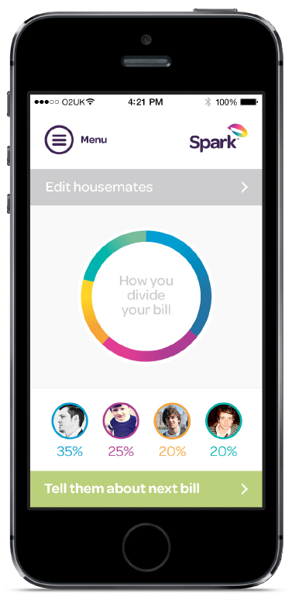
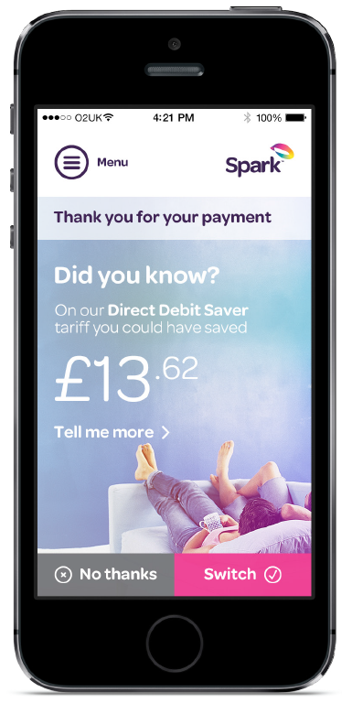
Coming Soon - APP
Notes:
Key messages
Roughly 3x profit growth expected with improved service, diversified offering and derisked operations.
Risks are now external (Ofgem, PR and political): we are well represented about small and unwilling to become distracted.
Margins remain tight and subject to risks. Diversifying offering, building efficiency / generation and protecting the core channel remain key
Alternative trading arrangements and exit strategies / options become considerations

